Slide 1

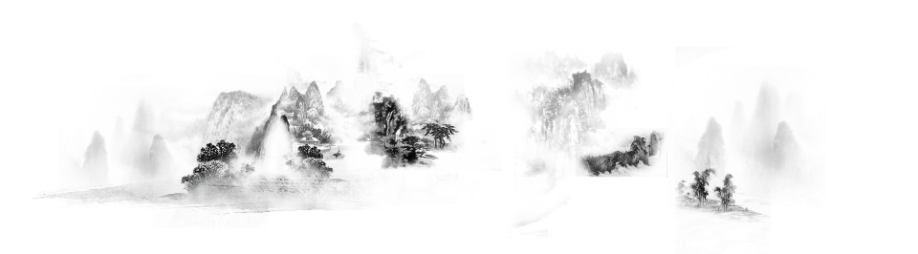
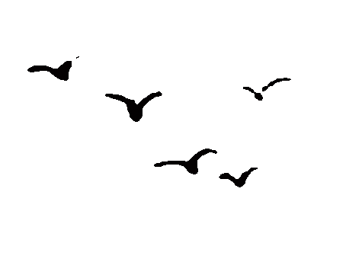
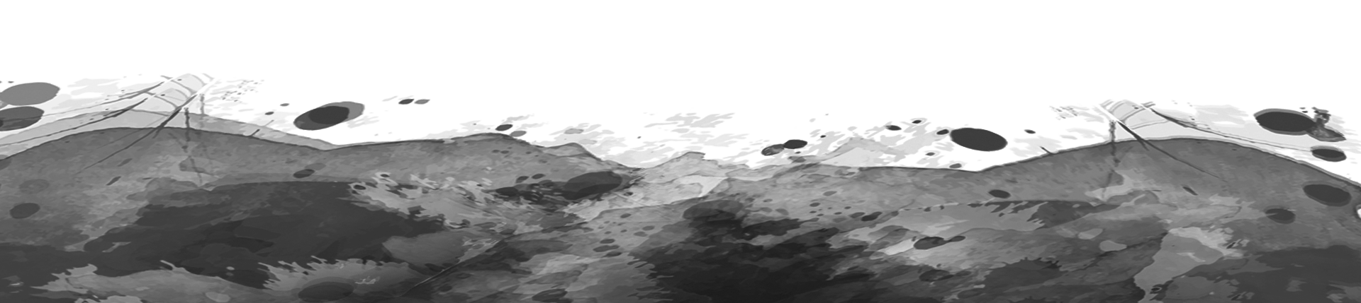
Picturesque Panorama of Jiangnan
Xiaoqi Lai (Alvan)
Media & Arts 206 Midterm Presentation

Slide 2
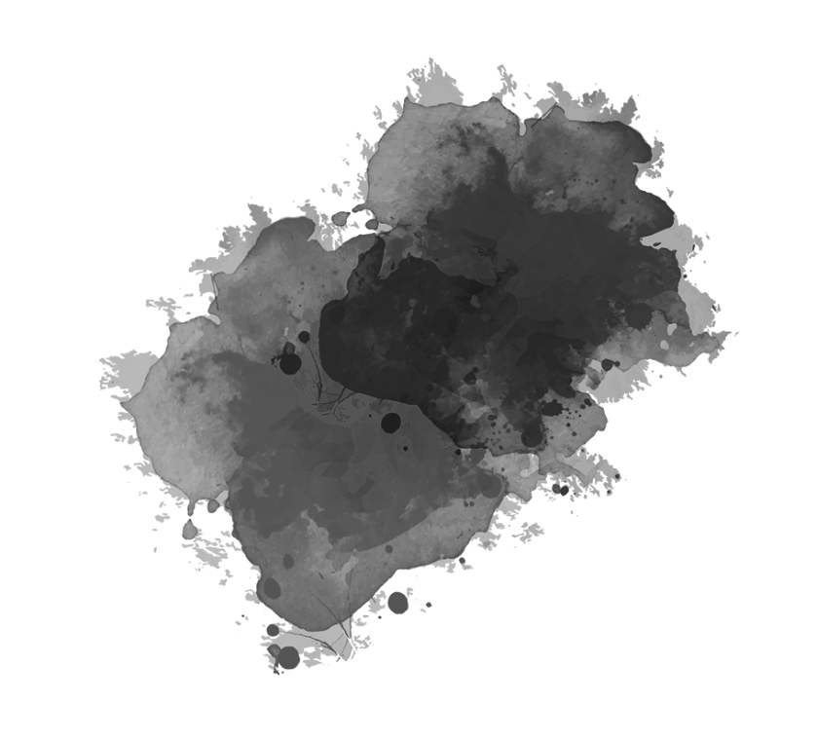

Roadmap
01
Inspiration
03
Construction
02
Concept Overview
04
Reflection

Slide 3
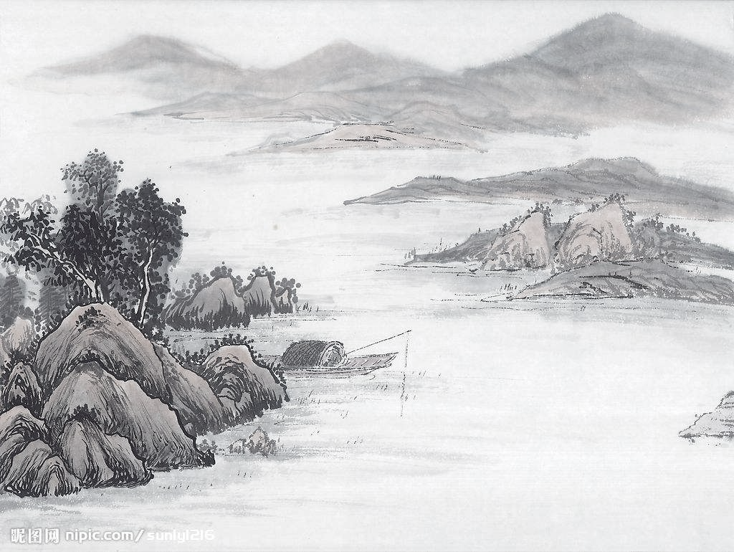
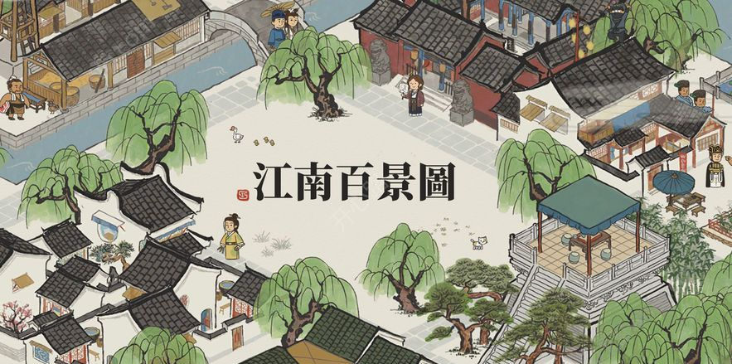
Inspiration
Chinese Ink and Wash Painting on Scrolls
(e.g., Along the River During the Qingming Festival)
Gameplay: 江南百景图 Picturesque Panorama of Jiangnan
(Jiangnan: South of the lower reaches of the Yangtze River)

Slide 4
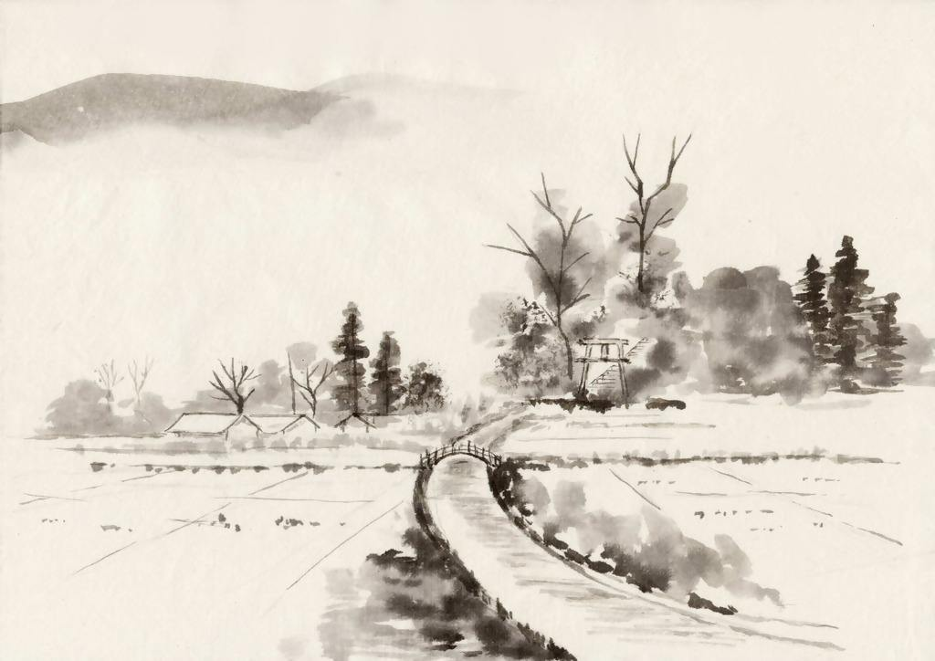
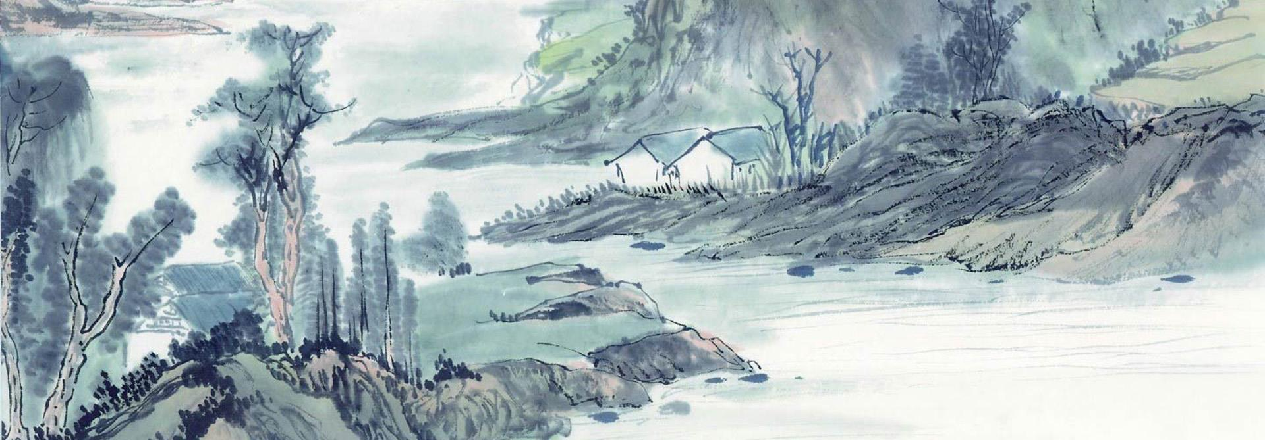
Concept
Nature & Human Landscapes
添加主题
Mountain
Water
Clouds
Architecture
……
Interaction & Non-interaction
添加主题
Automatic Animation
Keyboard Interaction
Mouse Interaction

Slide 5
Construction
Adobe Illustrator
Multiple Layers
Creation & Material Use
Audio
Implementation
OpenFrameworks
Particle System
Simple Animation
Automation & Activation

Slide 6
Reflection
Specifically focusing on nature, seeking balance between humans and nature
Convey
in-rooted features of Chinese cultures (classical art)
L
I
M
I
T
S

Slide 7
Thank you for watching!

